Slide 1

CODEBASICS RESUME CHALLENGE - MARCH
Designed and Presented By
Sana Afreen

Slide 2

Introduction
Your quest for the perfect dataset concludes here! 🌟 Join us in this challenge as we unlock invaluable insights for the revenue team at AtliQ hotels, utilizing the wealth of provided data. 📊

Slide 3
AtliQ
Bangalore
Delhi
Atliq Bay
Atliq Blu
Atliq City
Atliq Exotica
Atliq Grands
Atliq Palace
Mumbai
Hyderabad
Atliq Bay
Atliq Blu
Atliq City
Atliq Grands
Atliq Palace
Atliq Bay
Atliq Blu
Atliq City
Atliq Exotica
Atliq Grands
Atliq Palace
Atliq Seasons
Atliq Bay
Atliq Blu
Atliq City
Atliq Exotica
Atliq Grands
Atliq Palace

Slide 4
Data Set Details
We are provided 3 months of booking details data of all the AtliQ hotels.
The dataset contains 5 Excel files.
Dim_date
Dim_hotels
Dim_rooms
Fact_aggregated_bookings
Fact_bookings
Metric list Excel file
Mock-up Dashboard

Slide 5
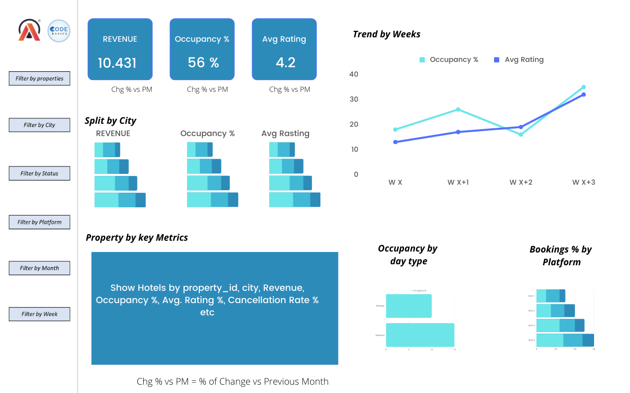
Mockup Dashboard

Slide 6
Expected outcome after this analysis?
Regain their market share in the luxury/business hotels category
Understanding the revenue trend by week/month/day
To get insights where business is failing and what can be done to tackle them

Slide 7

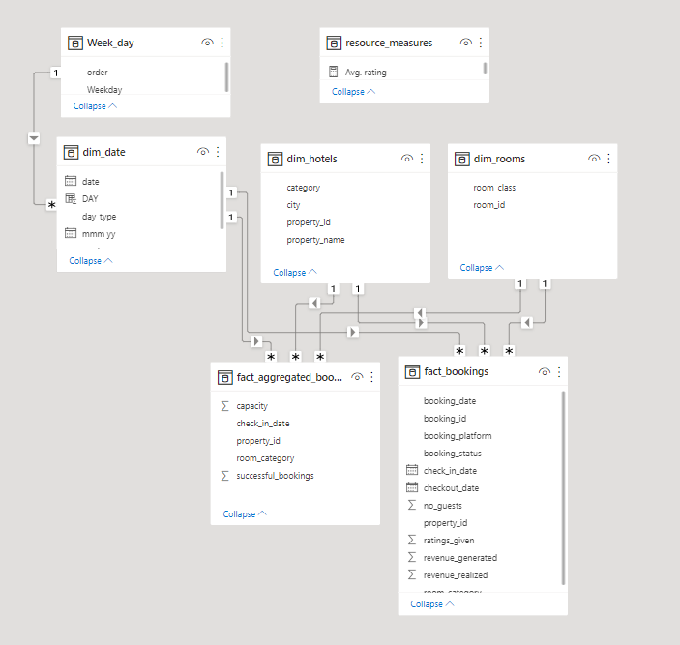
Data Model

Slide 8
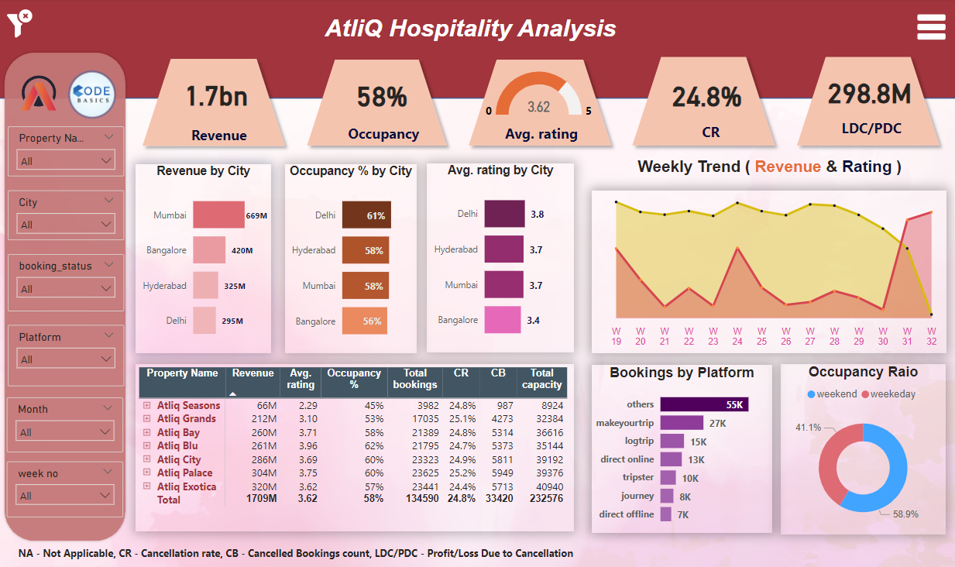
Data Model

Slide 9



